Slide 1
Byblos Bank Syria
Human Resources
Organization Structure
By: Rahaf Tarraf, Acting Head of HR
April 23, 2023

Slide 2
Agenda
Introduction
Current Structure
Updated Structure (By Unit)
Policies Amendment
Organizational Structure – Human Resources

Slide 3
Introduction
Objective:
The primary goal of this presentation is to seek backing and endorsement for the proposed modifications to the organizational framework of Byblos Bank Syria. These adjustments will allow us to harmonize our structure with our strategic objectives and regulatory standards, as well as open up growth prospects for our staff. Additionally, we will address issues such as policy amendments, signatures and financial limits, and succession planning.
Organizational Structure – Human Resources

Slide 4
Rationale for Change
Why the change
Regulatory requirements
Market Demand
Gaps in current structure
Organizational Structure – Human Resources

Slide 5
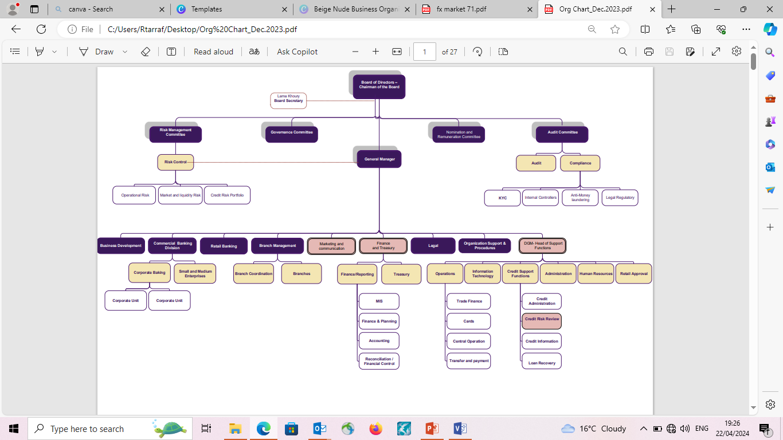
Current Structure
Organizational Structure – Human Resources

Slide 6
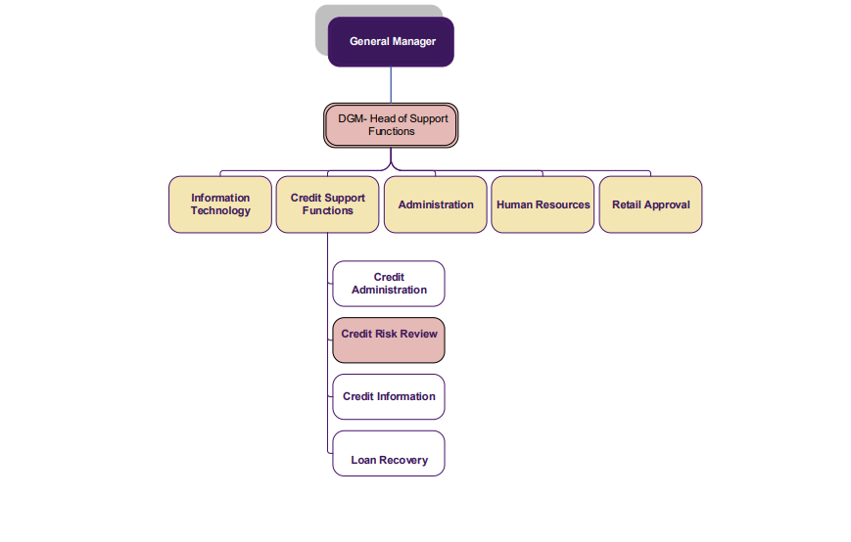
Current Structure
Organizational Structure – Human Resources

Slide 7
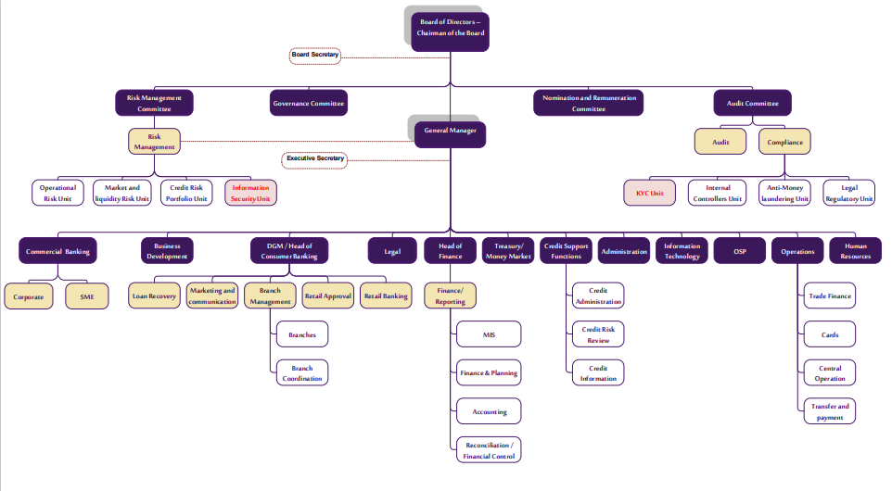
Structure –(Updated)
Organizational Structure – Human Resources

Slide 8
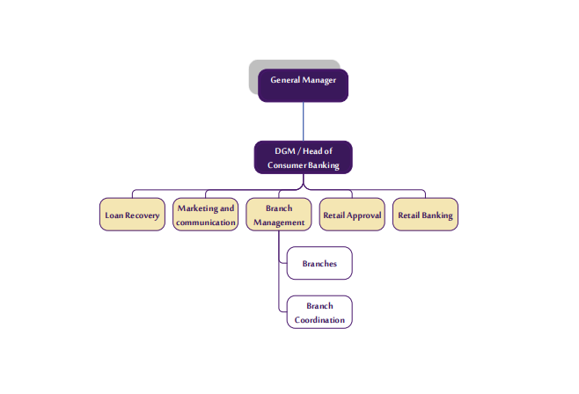
Structure –(Updated)
Changes
New Role
Organizational Structure – Human Resources

Slide 9
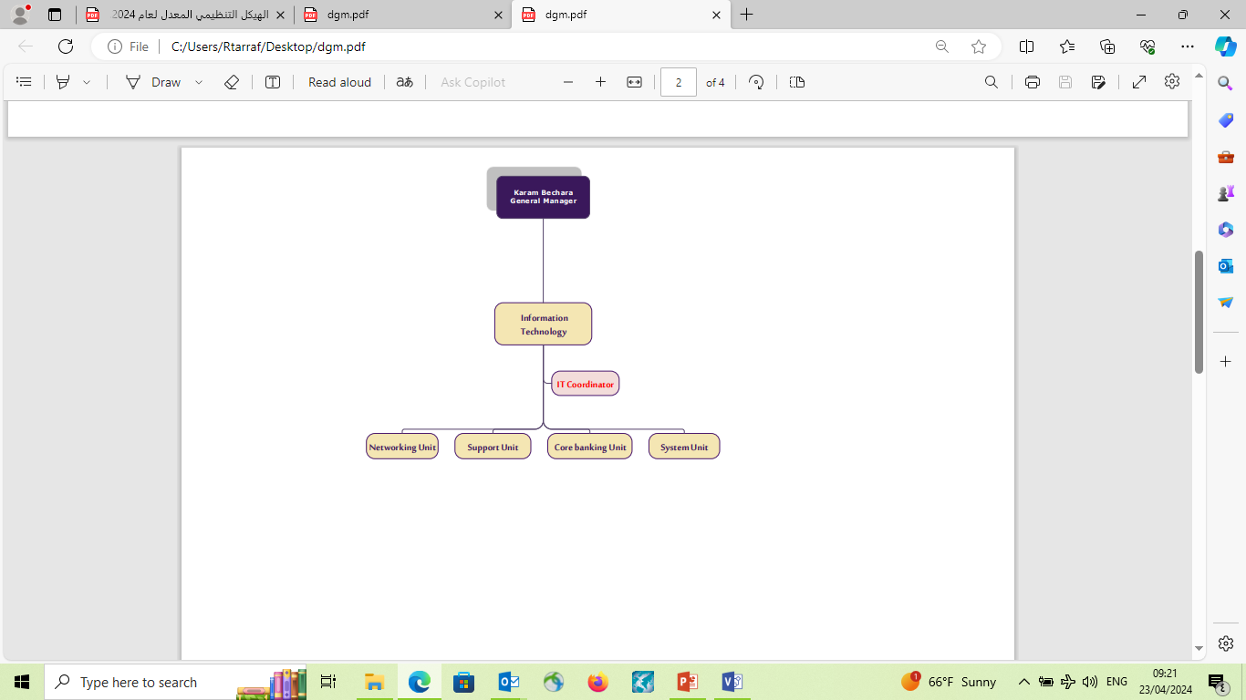
Structure – IT (Updated)
Changes
New Role
Organizational Structure – Human Resources

Slide 10
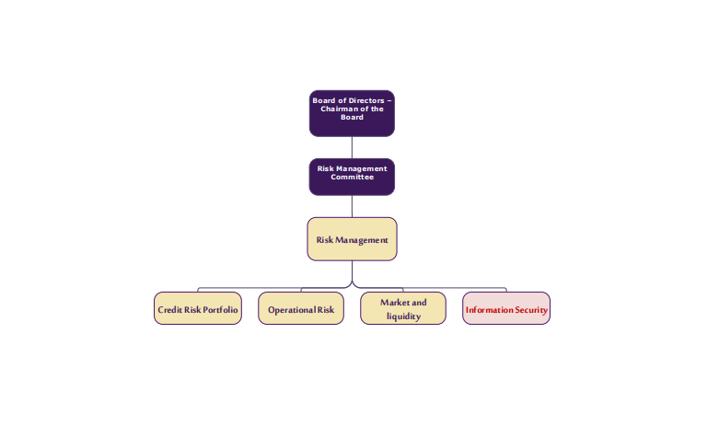
Structure – Risk Management (Updated)
Changes
New Role
Organizational Structure – Human Resources

Slide 11
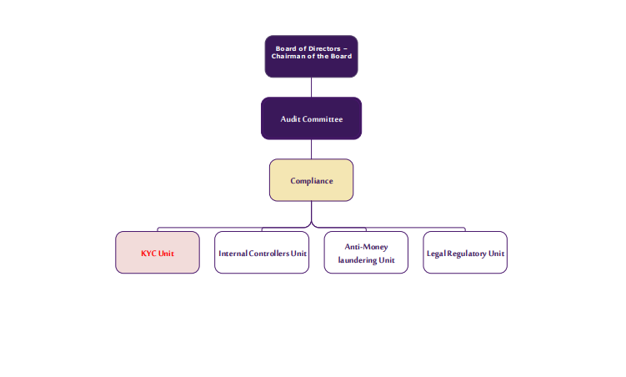
Structure – Compliance (Updated)
Changes
New Role
Organizational Structure – Human Resources

Slide 12
Decision Points
Decision Points
Structure
Titles
Organizational Structure – Human Resources

Slide 13
Policies Amendments - Continuous education program
Previously, employees were required to commit to working at BBS for one year for every SYP 100,000,000.
The current proposal suggests a commitment of 5 years for MBAs and high level education (costly). Once employees leave, the calculation will be based on pro rata basis. (100%, 80%,60%,40% & 20%)
If the employee leaves before 1 year 100%
If the employee leaves between the 1st and 2nd year → 80%
If the employee leaves between the 2nd and 3rd year → 60%
If the employee leaves between the 3rd and 4th year → 40%
If the employee leaves between the 4th and 5th year → 20%
3 years for small amounts and certifications based on pro rata too.
Organizational Structure – Human Resources

Slide 14
The End
Progress
in
Work
Thank You
Organizational Structure – Human Resources

